Slide 1
Structured Matching Pursuit for Reconstruction of Dynamic Sparse Channels
Presenter: Xudong Zhu
Authors: Xudong Zhu, etc.
Tsinghua University, Beijing, China
Notes:
Hi, everyone.
I am Xudong Zhu, come from Tsinghua University, Beijing, China.
The title of my paper is structured matching pursuit for reconstruction of dynamic sparse channels.

Slide 2
Background
Channel state information (CSI)
Training sequences are usually utilized for channel estimation
Overhead of training sequences reduces spectrum efficiency
Compressive sensing (CS)
CS is able to recover channel from much less measurements
CS can be utilized to reduce the length of training sequences
Various CS algorithms
OMP: Orthogonal matching pursuit
CoSaMP: Compressive sampling matching pursuit
SOMP: Simultaneous OMP
……
Notes:
This slide is about introduction.
In most wireless communication systems, channel state information is very important.
Training sequences are usually utilized to for channel estimation.
And the spectrum efficiency loss is unavoidable due to the overhead of training sequences.
In recent years, compressive sensing technology has been widely adopted for channel estimation.
Accurate CSI can be recovered by CS technology based on reduced training sequences.
There are a lot of CS algorithms, the famous OMP, CoSaMP, and so on.

Slide 3
System Model
Channel estimation based on training sequence
$$y^{(t)}=Φh^{(t)}+n^{(t)}, t=1,2,⋯,τ,$$
$y^{(t)}={\left[y_{1}^{\left(t\right)},y_{2}^{\left(t\right)},⋯, y_{M}^{\left(t\right)}\right]}^{T}$ denotes the linear measurement;
$h^{(t)}={\left[h_{1}^{\left(t\right)},h_{2}^{\left(t\right)},⋯, h_{N}^{\left(t\right)}\right]}^{T}$ denotes the channel vector, $N>M$;
$Φ∈ℂ^{M×N}$ is a Toeplitz matrix based on $c={\left[c_{0},c_{1},⋯,c_{M}\right]}^{T}$;
$n^{(t)}∼CN\left(0,σ_{n}^{2}I_{M}\right).$
Notes:
The system model is very simple.
At each time slot, we have linear measurement y^(t) of the channel vector h^(t).
And we have a series of such measurements for different time slot.
Here, \Phi is sensing matrix, we assume it is the same one at all time slots.

Slide 4
Temporal correlation of dynamic channels
Common path delay set
$$Γ_{com}=\{i:i∈Γ^{\left(t\right)},t=1,2,⋯,τ\},$$
$Γ^{(t)}=\{i:i∈Ω,h_{i}^{\left(t\right)}≠0\}$ denotes the path delay set of $h^{(t)}$;
$Ω=\{1,2,⋯,N\}$ denotes the entire set;
$\left|Γ_{com}\right|=L≤K$ denotes the size of the common path delay set;
$L$ denotes the temporal correlation degree of dynamic sparse channels.
Notes:
This page models the dynamic channel.
The i-th value in t-th time slot channel vector, i.e., h_i^(t) is determined by two parameters, i.e., s_i^(t) and a_i^(t).
Specifically, s_i^(t) belongs to 1 or 0 denotes the whether there is a non-zero channel tap.
a_i^(t) denotes the corresponding path gain.
We model all these parameters in a probability model.
s_i^(t) is modeled as a discrete Markov process, p_0->1 denotes the probability when s_i^(t-1) equals to 0 while s_i^(t) equals to 1.
a_i^(t) is modeled as a Gauss-Markov process.

Slide 5
Dynamic Channel Model
Fig1. Illustration of the dynamic Vehicular B channel.
Notes:
Intuitively, this fig indicates the dynamic sparse channel.
We can see that path gains evolve smoothly over time slots, i.e., Gauss-Markov process of a_i^(t).
Also, a disappeared tap in time slot 2 and 3, i.e., s_i^(1)=1, while s_i^(2)=s_i^(3)=0.
A burst tap in time slot 3, i.e., s_i^(1)=s_i^(2)=0, while s_i^(3)=1.

Slide 6
Key idea
Common channel taps detection
A series of received measurements can be utilized to improve the detection performance of common channel taps
Common channel taps estimation can be utilized for initialization for channel estimation for any specific time slot to reduce computational complexity
Dynamical channel taps detection
Before detecting dynamical channel taps, common channel taps have been already detected
Dynamical channel taps are added to replace the wrong channel taps in the common channel taps set
Notes:
This page models the dynamic channel.
The i-th value in t-th time slot channel vector, i.e., h_i^(t) is determined by two parameters, i.e., s_i^(t) and a_i^(t).
Specifically, s_i^(t) belongs to 1 or 0 denotes the whether there is a non-zero channel tap.
a_i^(t) denotes the corresponding path gain.
We model all these parameters in a probability model.
s_i^(t) is modeled as a discrete Markov process, p_0->1 denotes the probability when s_i^(t-1) equals to 0 while s_i^(t) equals to 1.
a_i^(t) is modeled as a Gauss-Markov process.

Slide 7
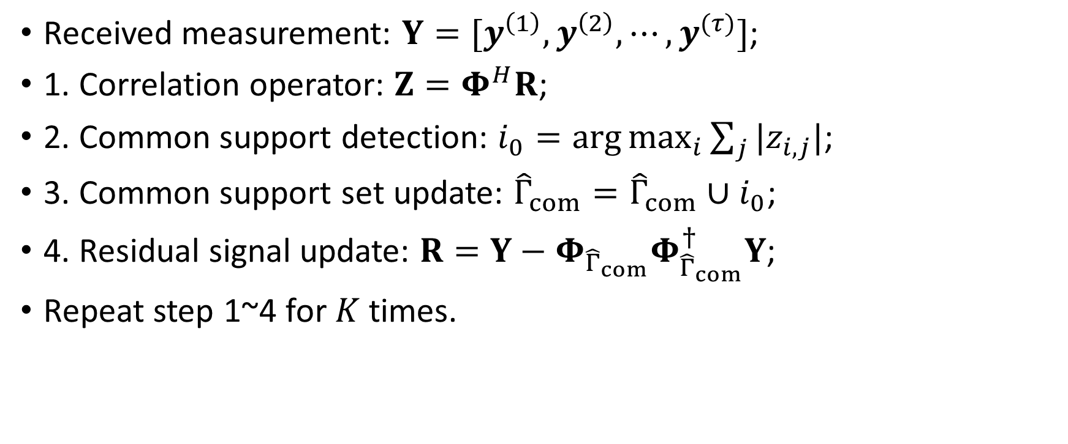
Common channel taps detection
Received measurement: $Y=[y^{\left(1\right)}, y^{\left(2\right)},⋯,y^{(τ)}]$;
1. Correlation operator: $Z=Φ^{H}R$;
2. Common support detection: $i_{0}=\arg{\max_{i}{\sum_{j}{|z_{i,j}|}}}$;
3. Common support set update: ${\hat{Γ}}_{com}={\hat{Γ}}_{com}∪i_{0}$;
4. Residual signal update: $R=Y−Φ_{{\hat{Γ}}_{com}}Φ_{{\hat{Γ}}_{com}}^{†}Y$;
Repeat step 1~4 for $K$ times.
Notes:
The proposed differential detection is very simple in fact.
Step 1, when we do channel estimation for current time slot (t), we can assume that we have already obtained the channel estimate \hat{h}^(t-1) in former time slot (t-1).
Step 2, we can do differential detection based on different measurement, then we can obtain the channel differential vector \Delta h.
Step 3, based on the channel estimation in former time slot and the channel differential vector \Delta h, we can easily obtain the channel estimation for current time slot.

Slide 8
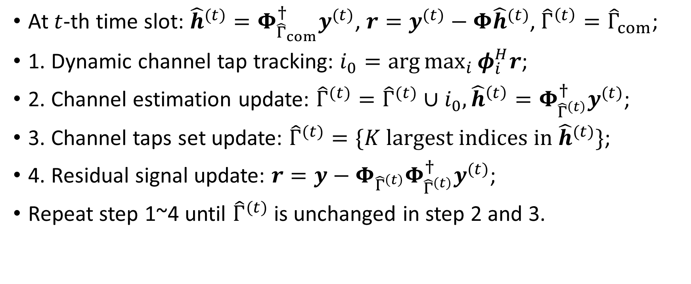
Dynamic channel taps tracking
At $t$-th time slot: ${\hat{h}}^{(t)}=Φ_{{\hat{Γ}}_{com}}^{†}y^{(t)}$, $r=y^{(t)}−Φ{\hat{h}}^{(t)}$, ${\hat{Γ}}^{\left(t\right)}={\hat{Γ}}_{com}$;
1. Dynamic channel tap tracking: $i_{0}=\arg{\max_{i}{φ_{i}^{H}r}}$;
2. Channel estimation update: ${\hat{Γ}}^{(t)}={\hat{Γ}}^{(t)}∪i_{0}, {\hat{h}}^{\left(t\right)}=Φ_{{\hat{Γ}}^{\left(t\right)}}^{†}y^{(t)}$;
3. Channel taps set update: ${\hat{Γ}}^{(t)}=\{K largest indices in {\hat{h}}^{(t)}\}$;
4. Residual signal update: $r=y−Φ_{{\hat{Γ}}^{\left(t\right)}}Φ_{{\hat{Γ}}^{\left(t\right)}}^{†}y^{(t)}$;
Repeat step 1~4 until ${\hat{Γ}}^{(t)}$ is unchanged in step 2 and 3.
Notes:
The advantages of the proposed differential detection come from three folders.
Just Read This Slide.

Slide 9
Simulation Setting
$N=200, M=100$;
$h_{i}^{(t)}∼𝒩\left(0,1\right), ∀i∈Γ^{(t)}$;
Delays of dynamical channel taps are randomly chosen from $Ω\backslash Γ_{com}$;
$τ=10$: coherence time of dynamical sparse channel;
$SNR∈\left[−10,30\right] dB$ of the received measurements;
$1≤L≤K$: temporal correlation.
Notes:
This page addresses the simulation setting.
Just some parameters for system model, especially for the dynamical sparse channel.

Slide 10
Simulation Counterparts:
Linear method: ${\hat{h}}^{(t)}={Φ^{†}y}^{(t)}$;
OMP: Simple CS method for each time slot;
SP: Improved CS method for each time slot;
A-SOMP: Improved CS method for several correlated time slots;
Oracle LS: Theoretical bound by assuming perfect knowledge of path delay set $Γ^{(t)}$.
Notes:
This page addresses the simulation setting.
Just some parameters for system model, especially for the dynamical sparse channel.

Slide 11
Simulation result (1)
Fig. 2. Correct detection probability of the common channel taps against SNR.
Notes:
Fig. 4 shows the MSE performance comparison against SNR for the five channel estimation methods.
It is clear that the standard OMP algorithm outperforms the linear method by about 1 dB, where the benefit comes from utilizing the channel sparsity.
Further, A-SOMP and HB-Kalman are better than the standard OMP algorithm by about 2 dB, since they
partially consider the temporal correlations of the dynamic sparse channel.
For the proposed D-OMP algorithm, it is evident that another 2 dB SNR gain can be achieved due to
its capability to track the dynamic sparse channel rapidly.

Slide 12
Simulation result (1)
Fig3. MSE performance comparison against the temporal correlation $L$ with SNR=5 dB.
Notes:
Fig. 2 shows the mean squared error (MSE) performance against time slot t for the five channel estimation methods.
It is clear that A-SOMP and HB-Kalmam achieve lower error levels than the standard OMP algorithm, while the conventional linear method performs worst.
The MSE performance of the proposed D-OMP algorithm is the best, as the temporal correlations of the dynamic sparse channel are efficiently exploited.

Slide 13
Simulation result (3)
Fig. 4. MSE performance comparison against SNR for different reconstruction algorithms with $L=5$.
Notes:
Fig. 3 shows the correct detection probability of a persistent channel tap against SNR.
It is evident that the hard threshold used in many CS-based channel estimation methods is not adapted to the SNR.
In this paper, we proposed threshold P_th based on noise statistics, the correct detection probability can
be improved further.

Slide 14
Thank you~
Notes:
Thank you~
Actually, I am not so clear about this threshold since I am not the author.
If you any question about this paper, you can send e-mail to the authors for more information.

